Slide 1
COMPUTER BASED TEST SYSTEM
WITH FINGERPRINT AUTHENTICATION
By:
UGOCHUKWU .F. CHINAZA 2015/198794
EGWU CHINELO .O 2015/200147
SUPERVISOR: Engr. Dr. V.C.Chijindu

Slide 2
Introduction
CBT systems with fingerprint authentication can be defined as the creation of an online platform as a primary means of testing students with the use of fingerprint biometric to verify each student before testing.

Slide 3
Problem Statement
massive examination leakages,
impersonations,
demand for gratification by teachers,
bribe-taking by supervisors and invigilators of examinations.

Slide 4
Aim Of Project
The aim of this project is to design and develop a Computer Based Test System with fingerprint Authentication

Slide 5
Objectives
To create a CBT application platform.
To provide Bio-metric Authentication for existing candidates.
To Provide section for Admin to upload Exam questions/ answers and edit.
To provide candidate result.

Slide 6
Related Works On CBT
Project 1:Online/Intranet Based Post Unified Tertiary Matriculation Examination (PUTME) For UNN in the year 2014.
  Achievements
The modules captured in this project are:
The registration module.
The question loading module.
The examination module.
The result module

Slide 7
Limitations of this work
Authentication using biometrics which was proposed was not achieved.
There was no provision for automatic generation of result marks and cutoff marks by the administrator.
There was no provision for the students to review their work.

Slide 8
Review Of Related Technologies
Hypertext markup language(HTML)
Cascading Style Sheet (CSS)
SQL
ASP.NET
Node.js
Mongo DB
C Sharp (C#)
Digital-Persona Fingerprint Reader

Slide 9
Methodology
There are different techniques to achieve this project such as bottom-up, top-down, structured etc. However in this project the top down approach was used because it enables us to start at the top to the bottom (i.e. the admin to the result level) as is represented in the figure below.

Slide 10
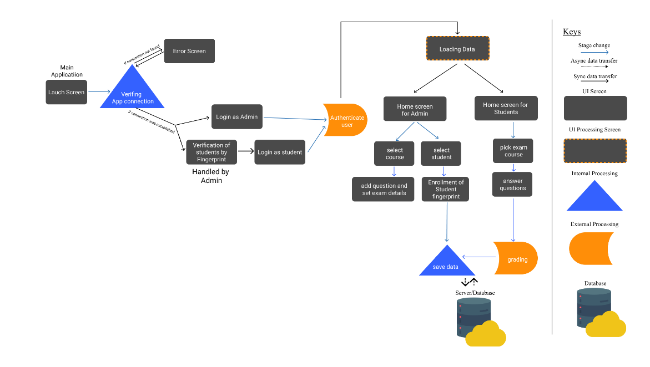
Methodology

Slide 11
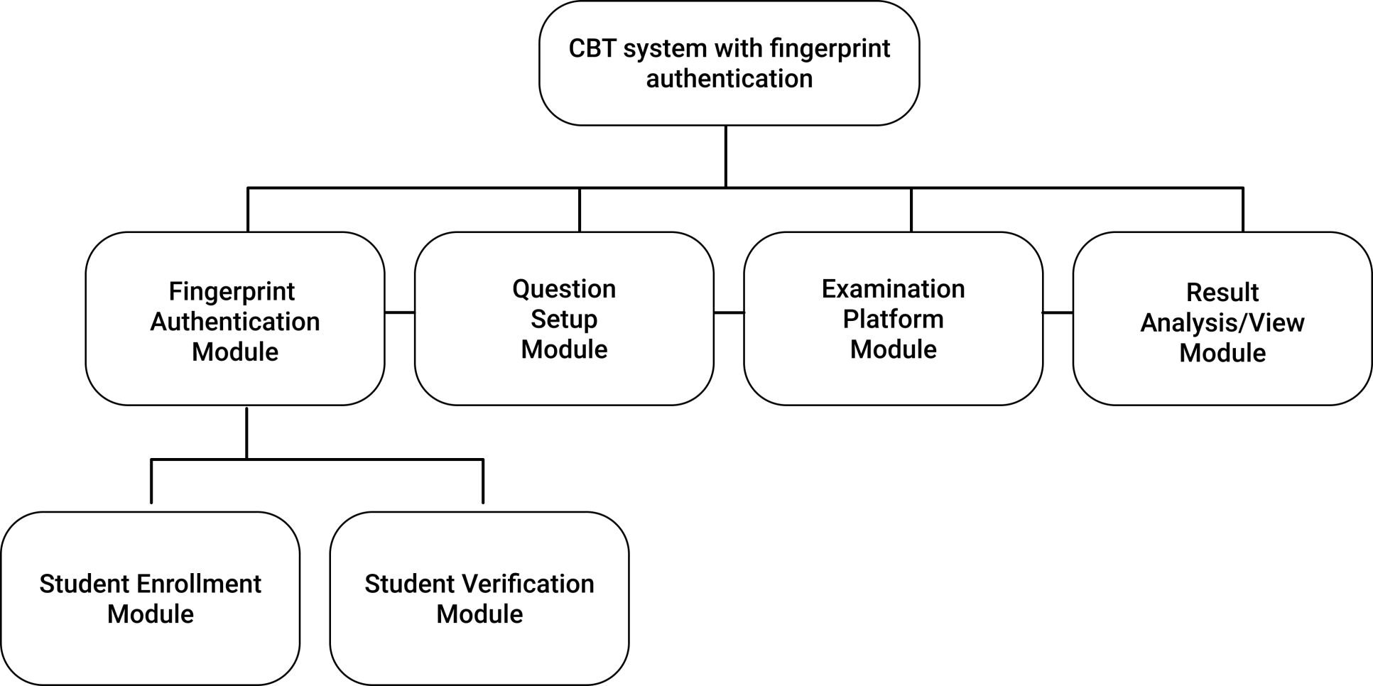
Design and Implementation
The design and implementation of this project can be broken in modules

Slide 12
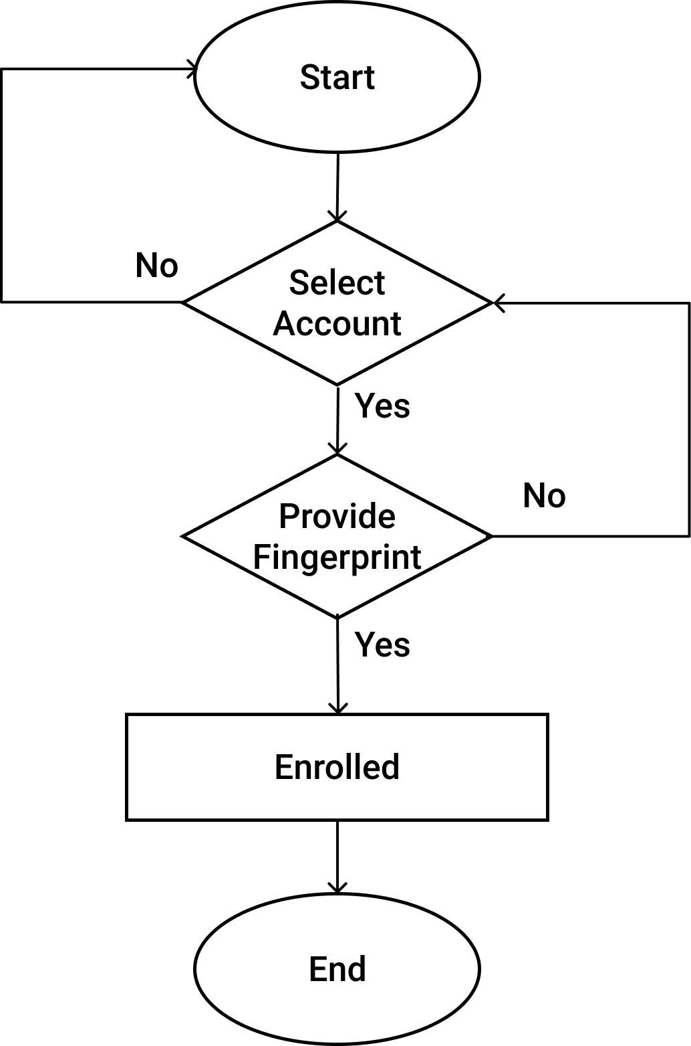
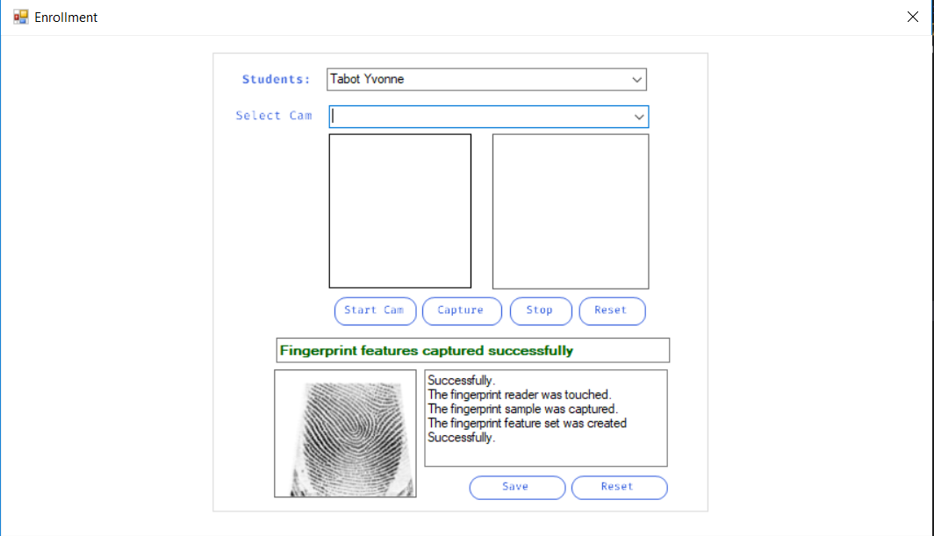
Student Enrollment Module

Slide 13
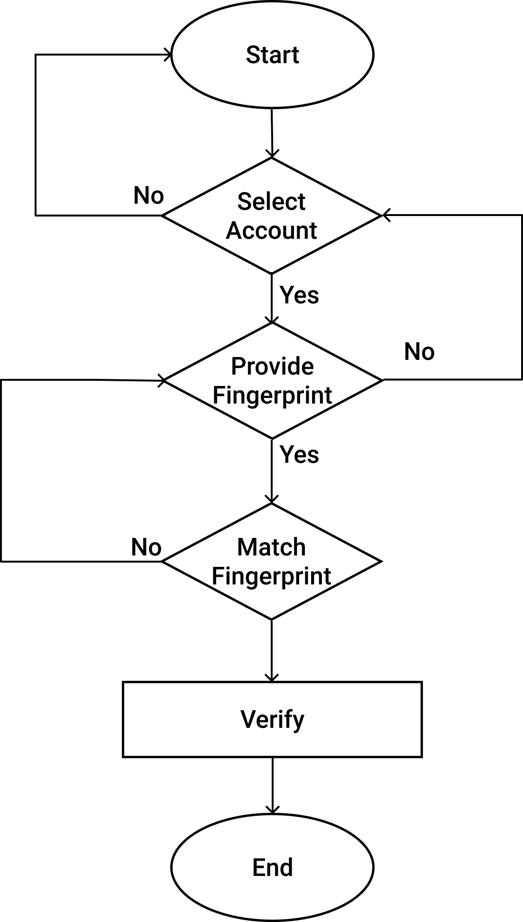
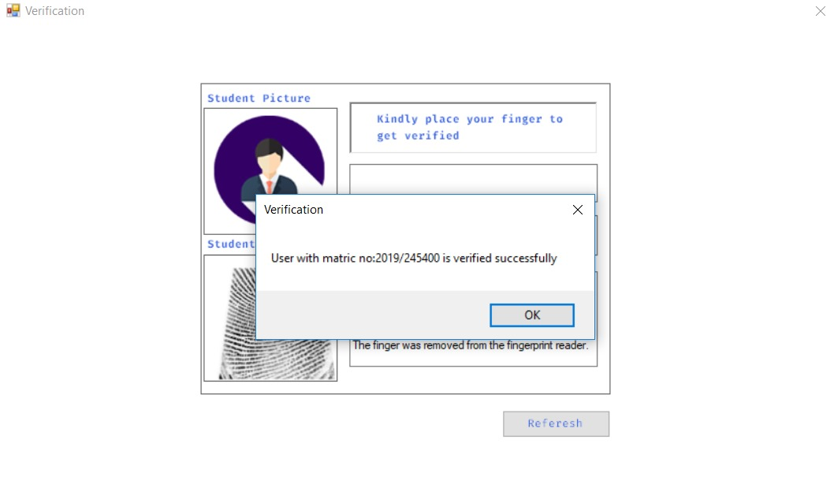
Student Verification Module

Slide 14
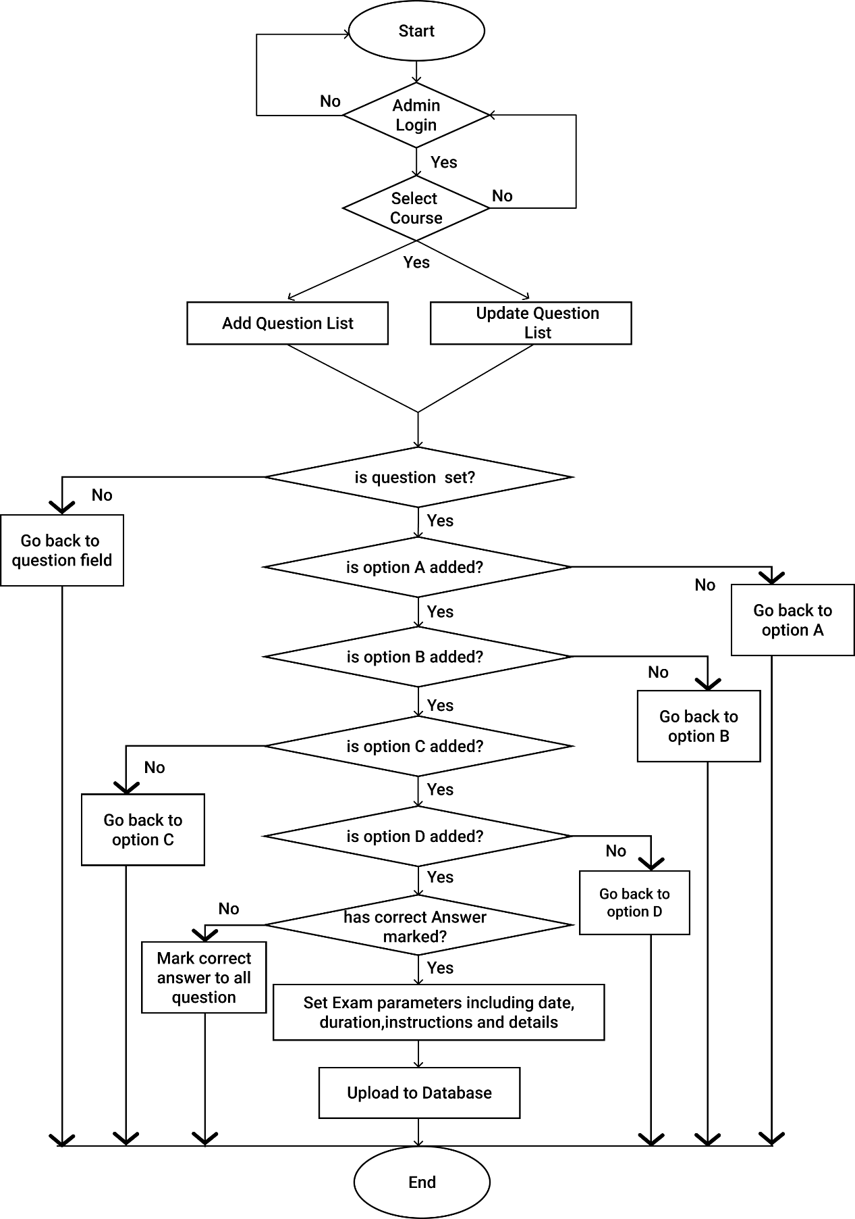
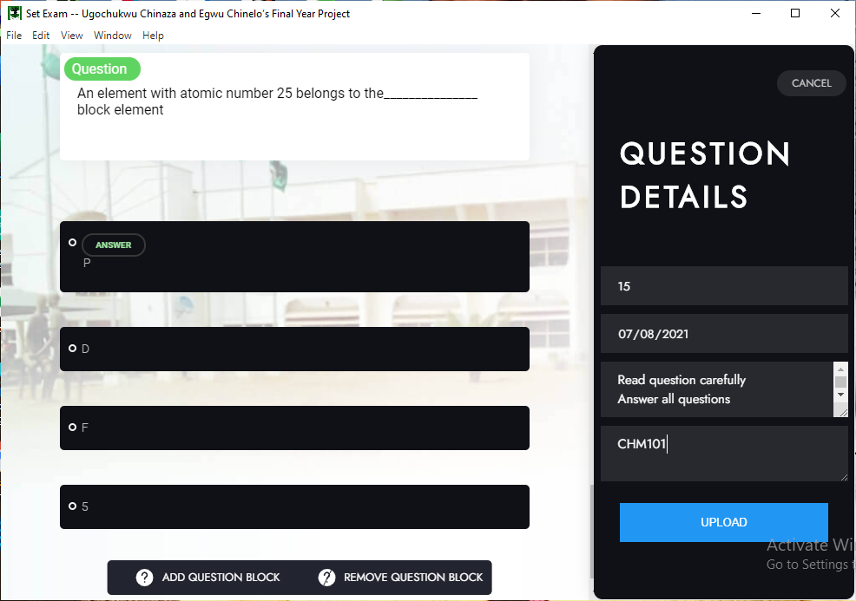
      Question Setup Module

Slide 15
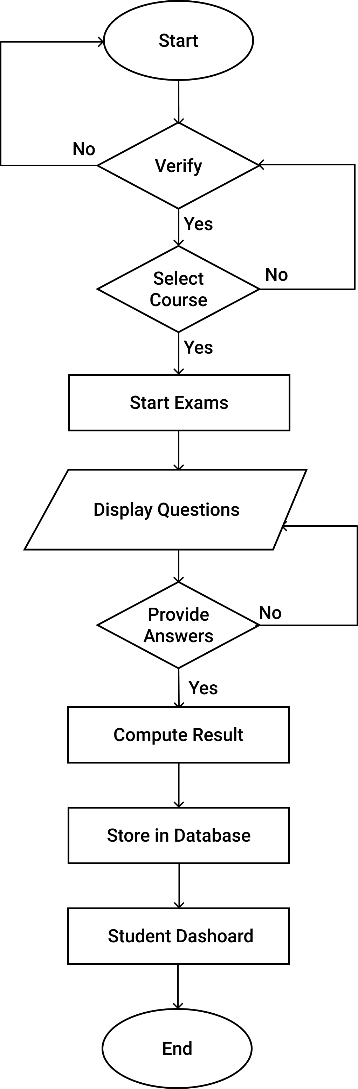
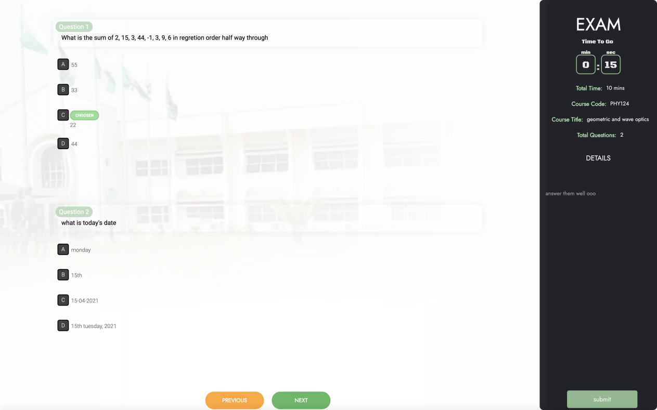
Examination Module

Slide 16
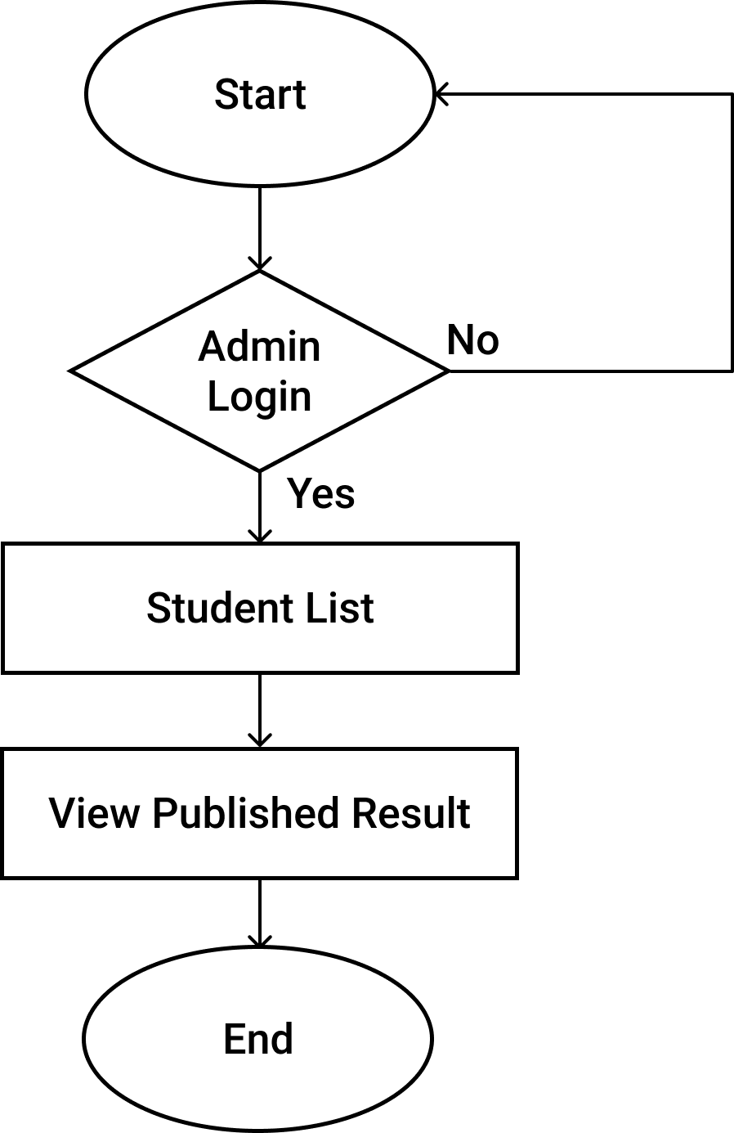
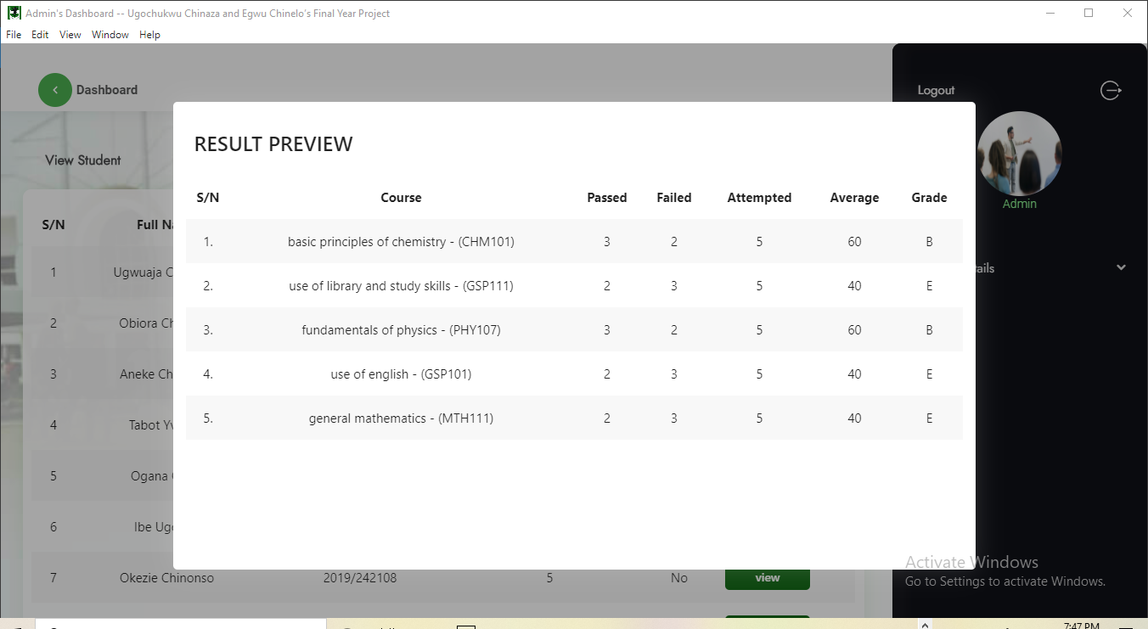
      Result Analysis/View module

Slide 17
Conclusion
The purpose of this project is to design an efficient and secured platform for conducting examinations. In spite of the fact that there were some limitations encountered due to economic and time factors most of the specified functionalities of the project were realized.

Slide 18
Limitations And Challenges
Only one admin exits on the system.
Proper web support for external accessories (fingerprint scanners) where not fully supported as such a desktop application platform was the only way to achieve the desired result.
Working with the digitalpersona U are U finger scanner has some limiting factors, as digitalpersona scanners does not support most programming languages. This made us to have two applications, one built with C# and the other built with Electron on Node Js. Which could have been done by building one application on one code base.

Slide 19
Recommendation
In addition to the unimodal approach employed in this study, we strongly believe that the use of multi-modal approach whereby more than one bio-metric indicators are combined will go further to strengthen the security of computer-based assessment.
Due to the fact that advancement in technologies occurs at a very rapid rate, constant improvement and research needs to be conducted to make sure it is in line with best technology practices.
Provision for result forwarding to candidates individually. This can be done by sending the result of each candidate through their emails or as a text message.
Web Supported or Fingerprint Scanner that support JavaScript should be used instead of the Digitalpersona Scanner which only supports low level programming languages.

